Slide 1
Zanmi Kafe:
“Quantifying Carbon for Cash”
Kate Baker, Nika Gorski, Caroline Willett
Notes:
Imagine if you had the resources and the knowledge to reverse the effects of climate change. To help someone make an idea come to life and fight social injustice? Well we jumped at the chance to do exactly that this summer by collaborating with Zanmi Kafe.
Hi. I’m Nika and this is Kate and Caroline and we are so excited to tell you about our work this summer.

Slide 2
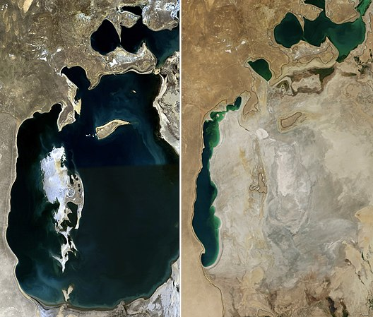
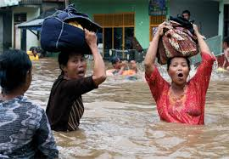
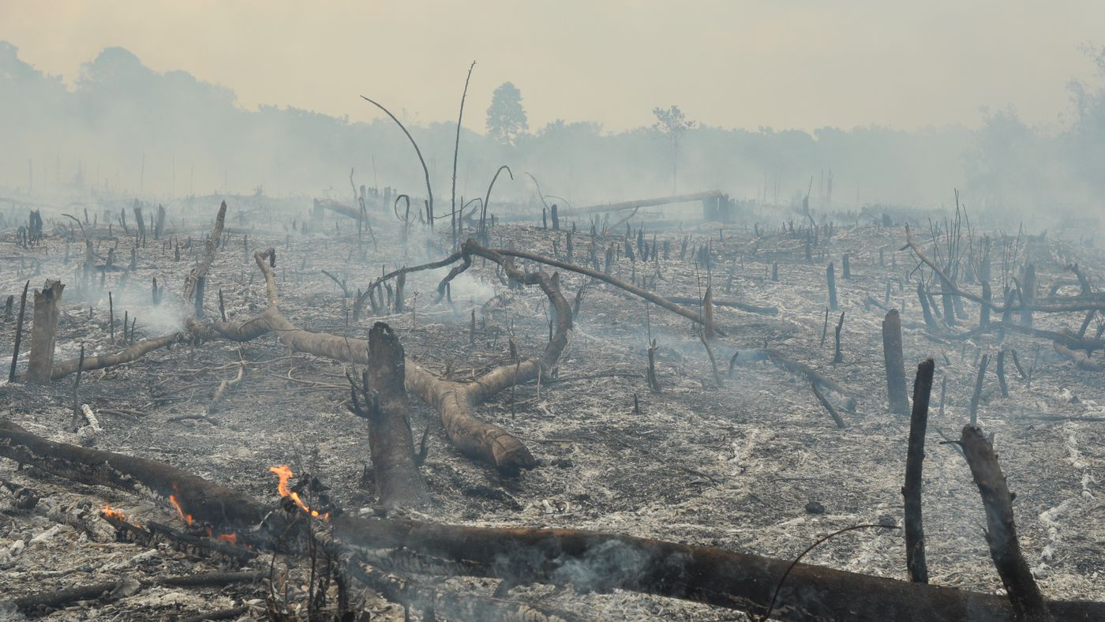
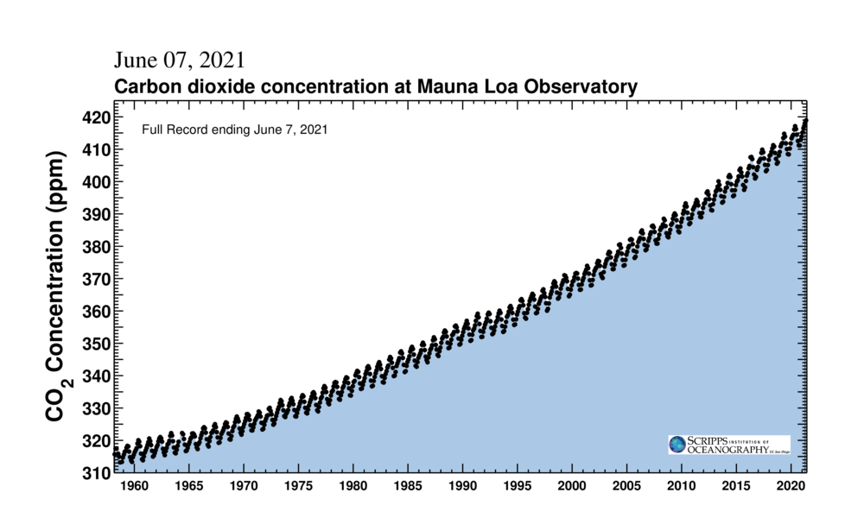
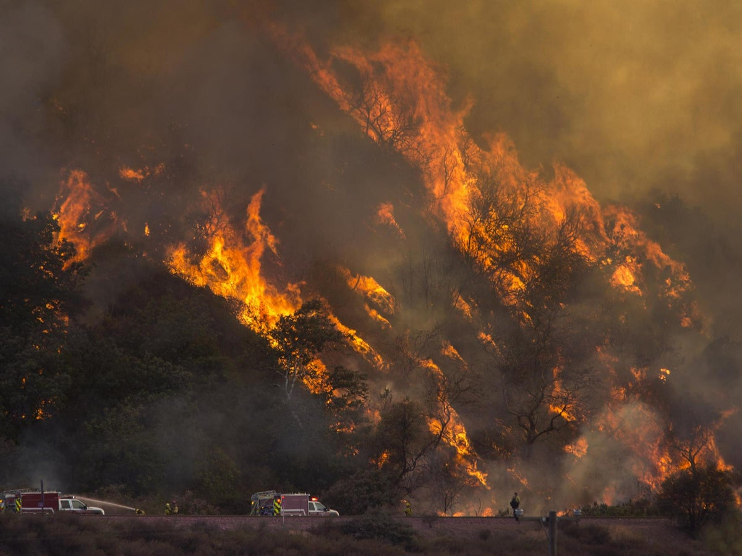
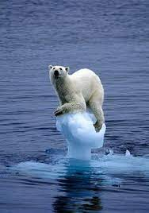
Notes:
Why is it important to combat climate change? Because it affects you, me, and for the sake of our project, the people of the Haitian Central Plateau.
Increasing levels of atmospheric carbon are causing a rise in global temperatures, which, if left unaddressed, will cause stronger natural disasters and erase biodiversity and ecosystem services. Specifically in Haiti, their lack of trees has led to a degraded and un-farmable landscape.
SOlutions to climate change are solutions to social injustice

Slide 3
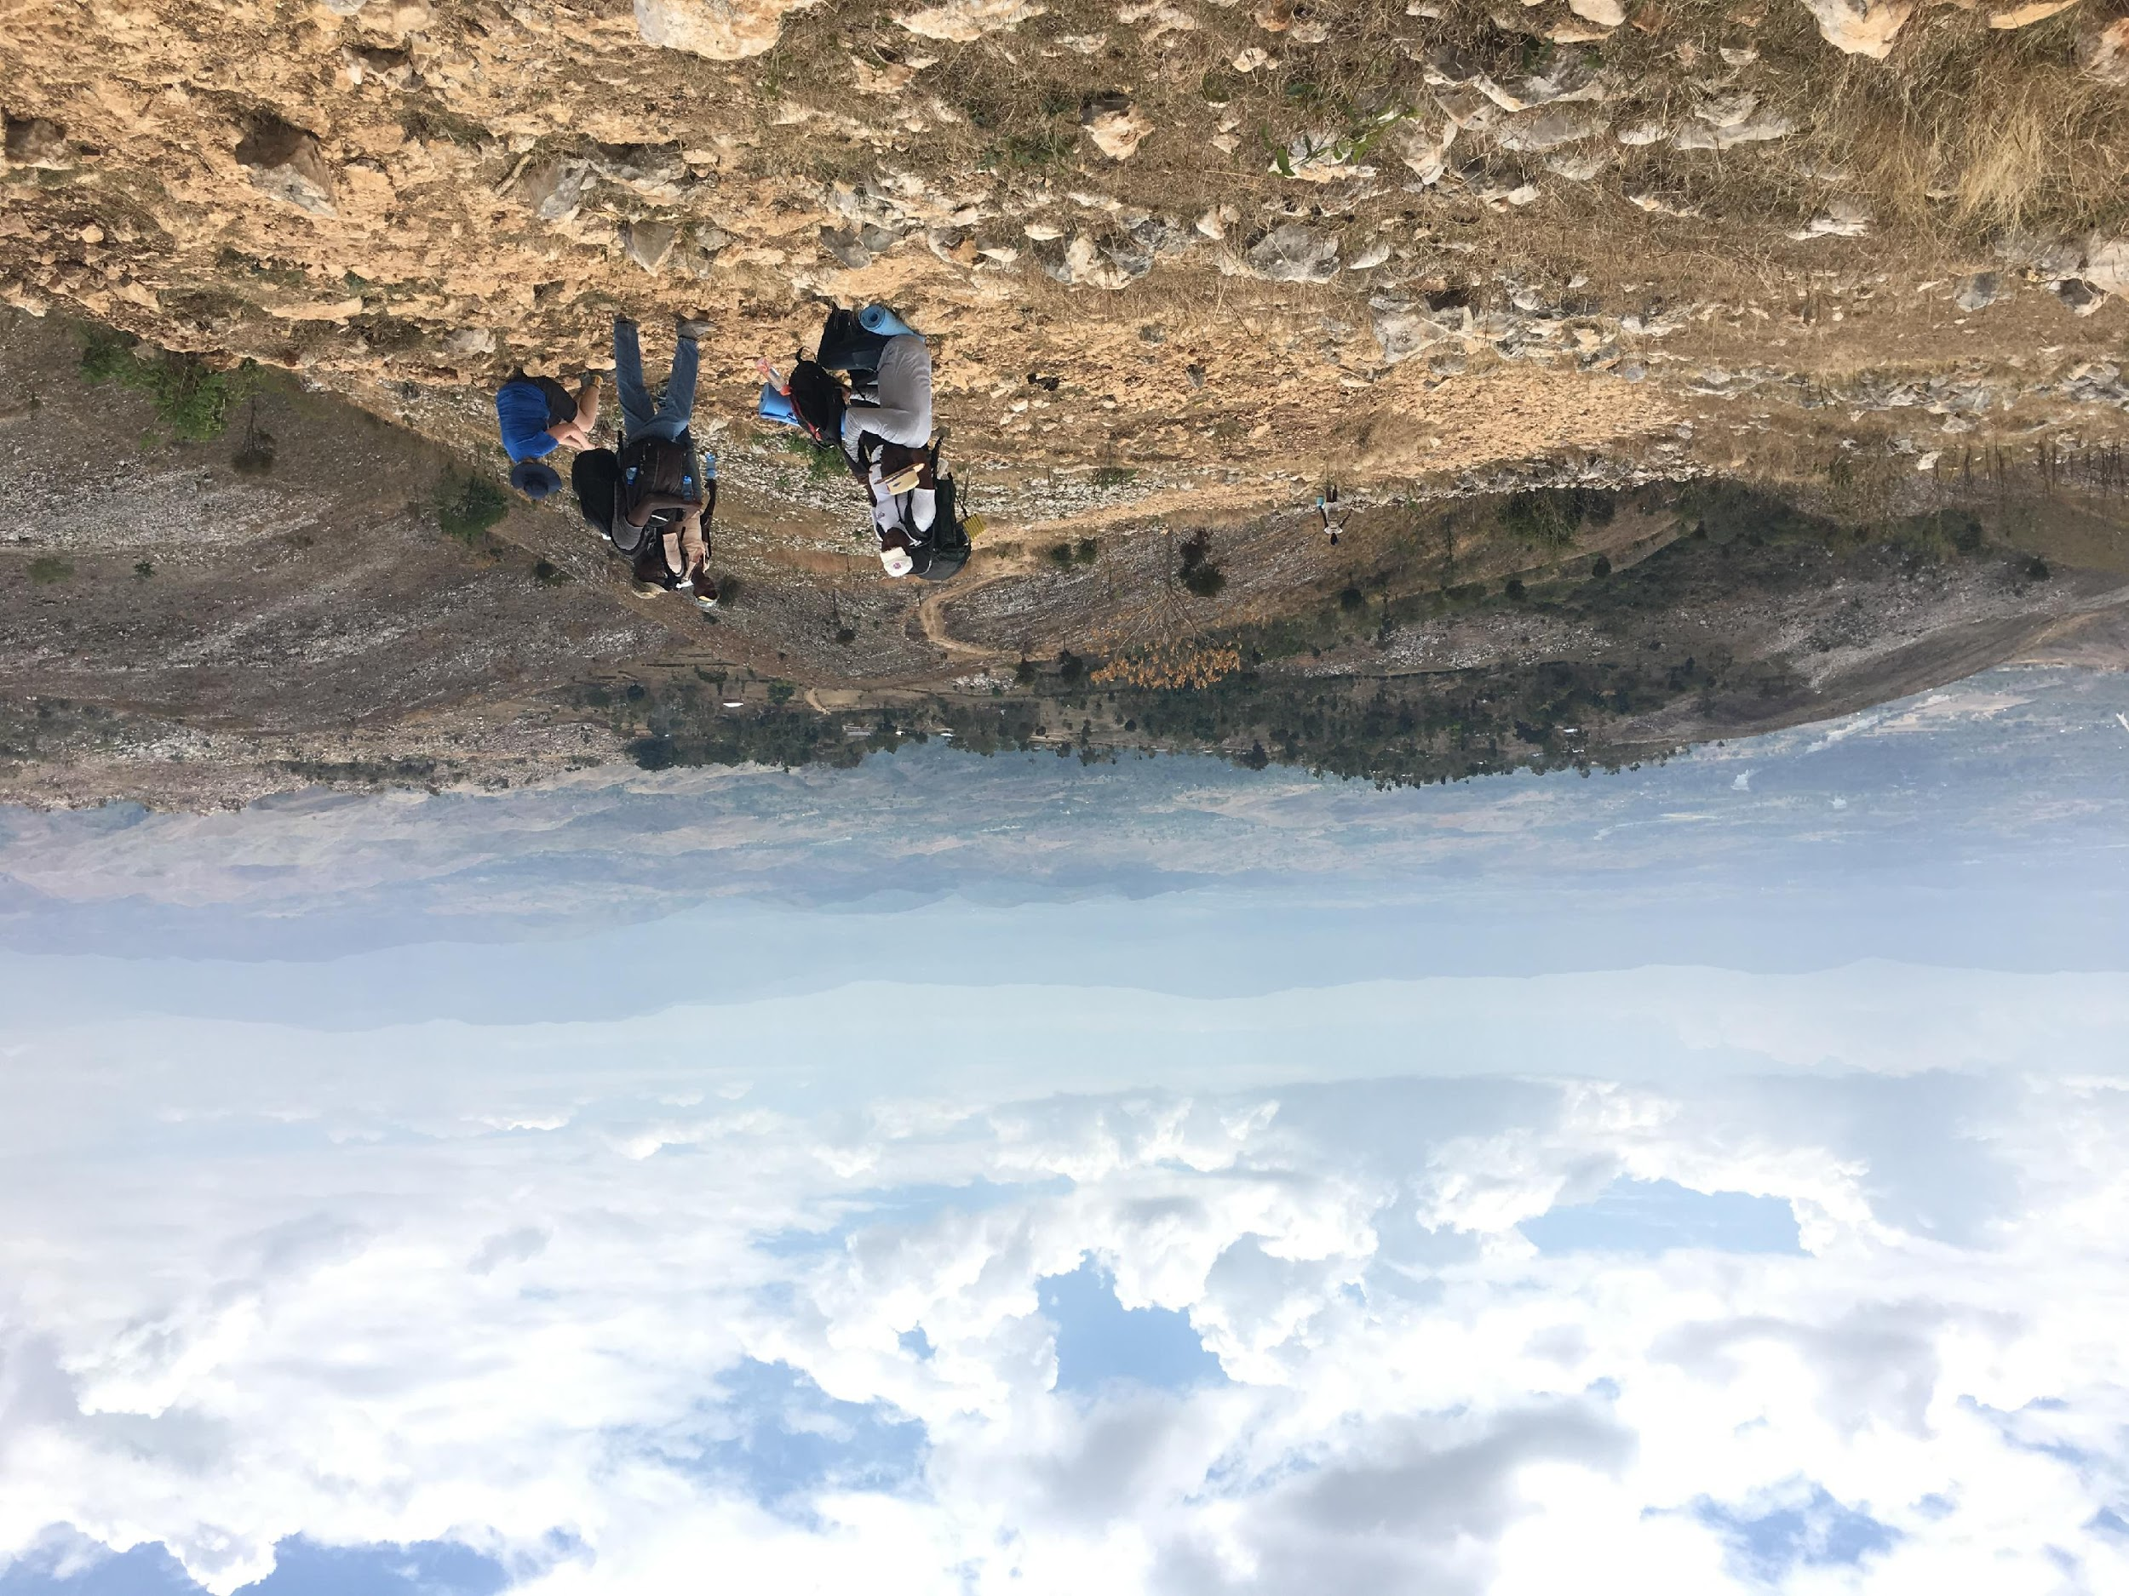
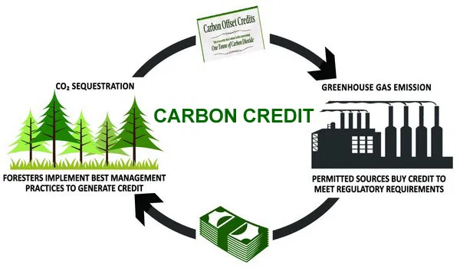
Carbon Markets:
A Tool to Combat Global Warming
Notes:
One way to combat climate change is through carbon markets. In carbon markets you have the emitter and the carbon absorber.
The absorbers are the trees that take in atmospheric co2 and use it to grow.
The emitters can pay money absorbers to plant trees that offset the c02 they emit. This is called a carbon credit.
In Zanmi Kafe’s carbon market, Sewanee pays Haitian farmers to offset students' travel to Haiti.
Carbon markets in third world countries like Haiti are important because planting trees improves soil health and enables Haitians to plant and sell crops, which brings about economic stability in the region.

Slide 4
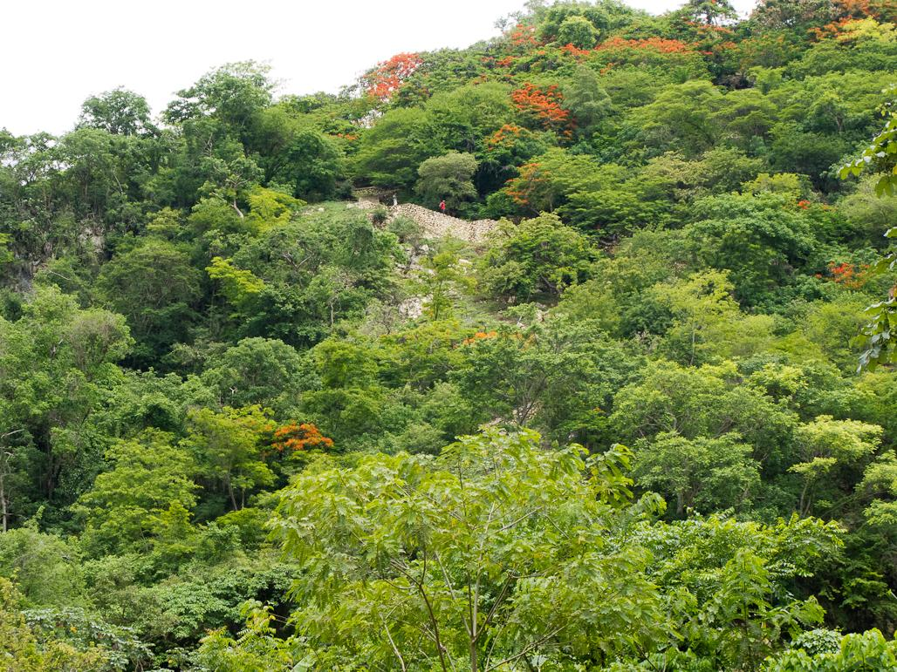
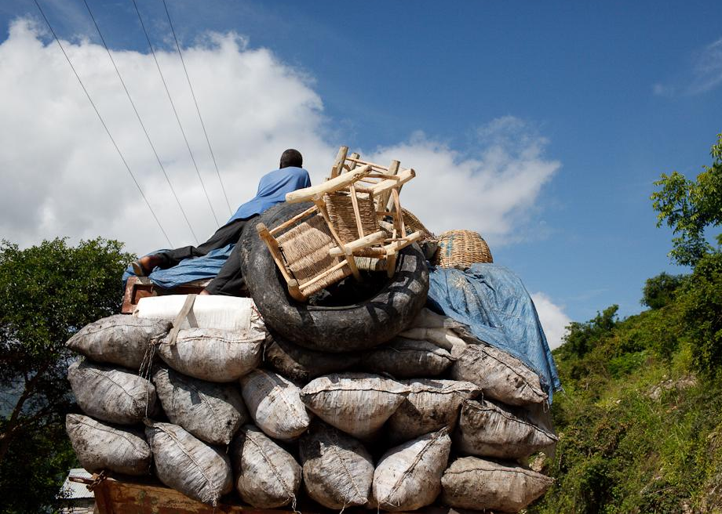
Carbon Payments
The price of carbon varies worldwide due to a lack of consensus on the carbon market.
$0.10 vs. $50
Charcoal sells for $50/sack
Planting trees has no market value
Notes:
The price of carbon varies all over the world due to the use of different equations. However, since planting trees has no value and charcoal is sold for $50/sack, Sewanee prices carbon at $50 a ton to incentivize the farmers to plant trees instead of cutting them down to sell charcoal. Zanmi Kafe is an example of a small-scale carbon market that works efficiently, but they had some issues that needed to be addressed for the project to be able to grow and reach their full potential.

Slide 5
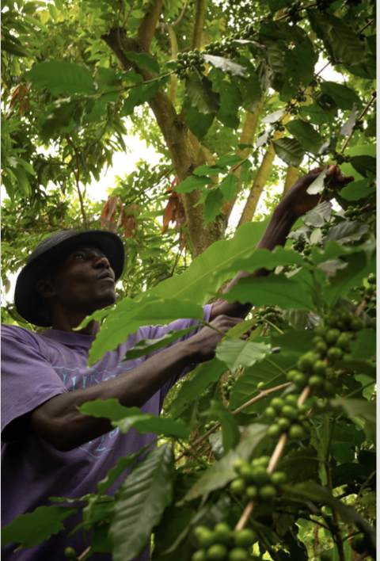
Problem Statement:
Zanmi Kafe needed a uniform process to explore and analyze their data, to accurately quantify carbon sequestration, and to efficiently pay Haitian farmers.

Slide 6
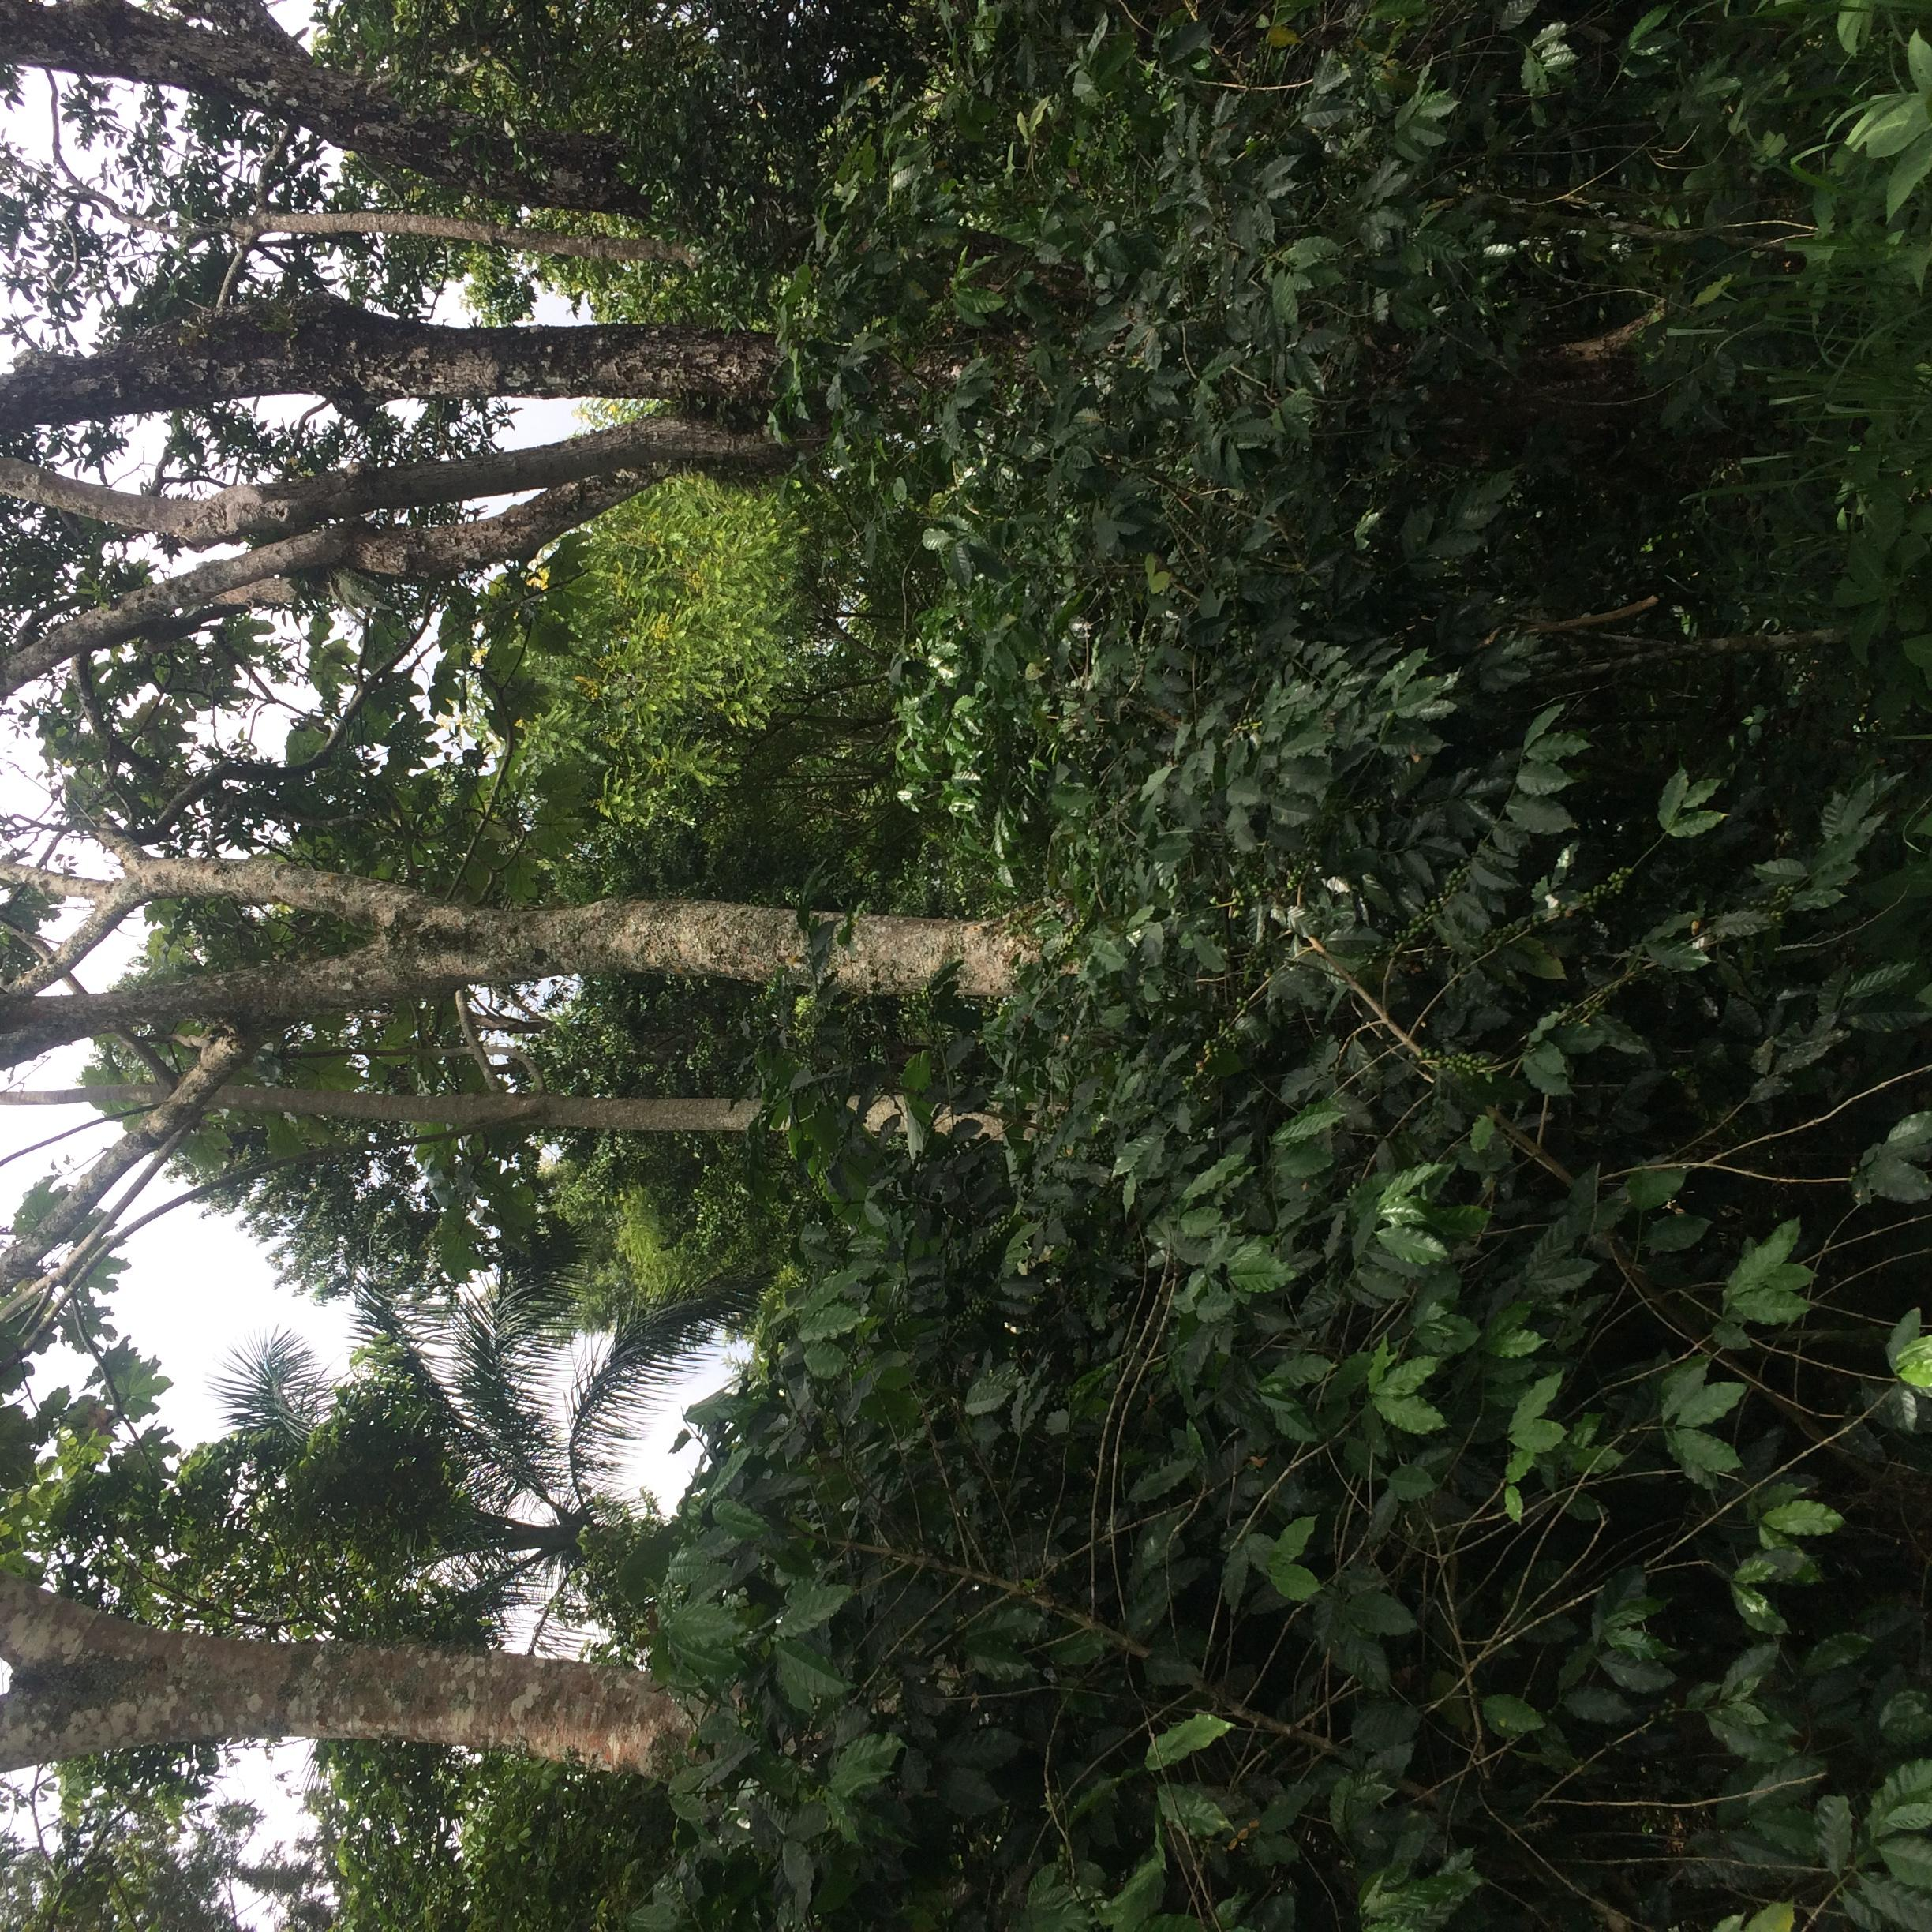
Solution to This Problem
Notes:
Our solution is to standardised a way to process and visualise large quantities of data with a public, interactive dashboard

Slide 7
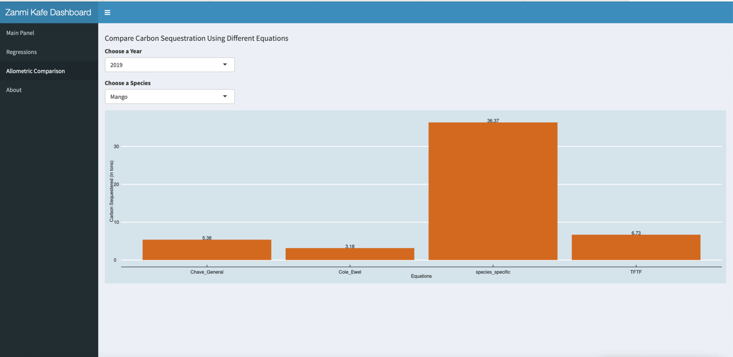
Finding correct equations to calculate carbon absorption:
Notes:
First we wanted to find correct equations to calculate carbon absorption since multiple equations exist that produce very different results. As you can see here, each bar shows carbon absorption according to different equations and there is a large difference between the bars, therefore it was imperative for us to find and use the correct equation to pay farmers accurately.

Slide 8
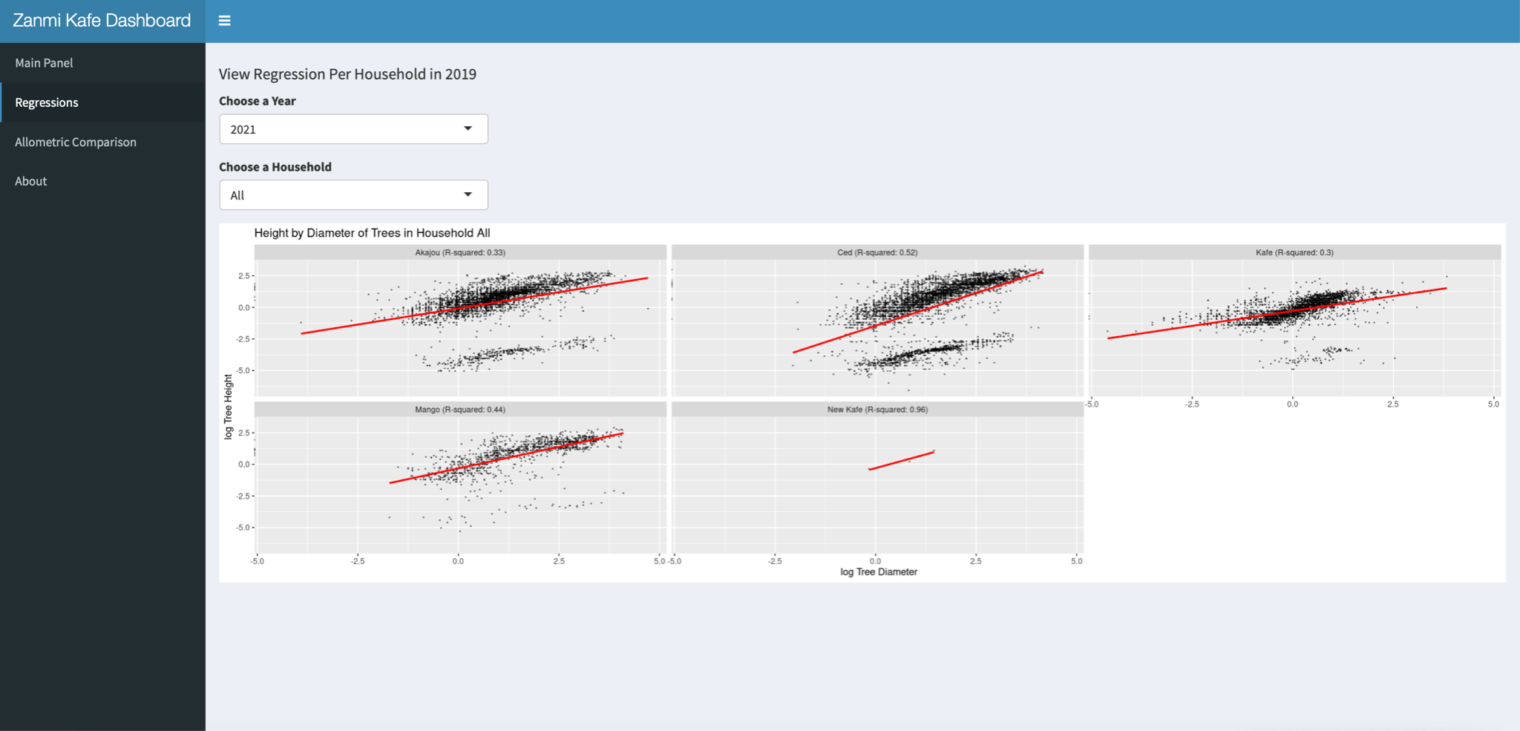
Creating a way to visualize raw data:
Notes:
The regressions tab is a great way to visualize large amounts of data. This tab shows the measurements of individual trees based on year and farm, which allows us to analyze variance and identify possible errors/discrepancies in the data collection. For example, you want the tree measurements to follow a trendline and if the measurements are not near that line then that means that some error occurred when the data was recorded or was input into the database, which allows the Zanmi Kafe to react appropriately.

Slide 9
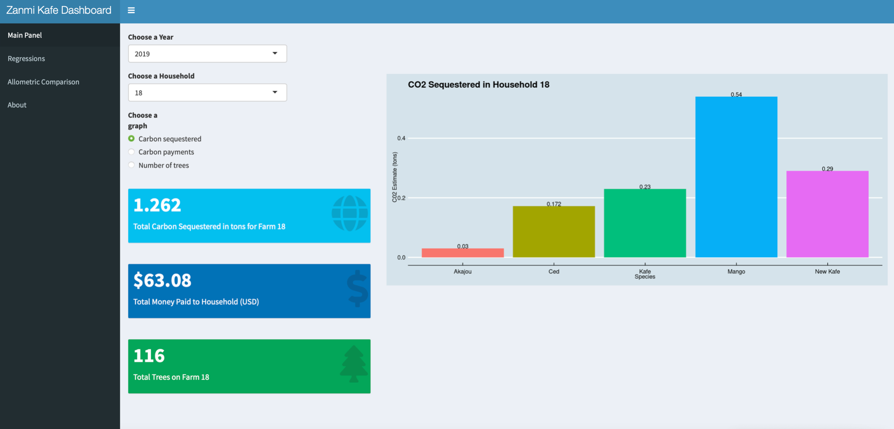
Developing a process to measure carbon sequestration and carbon payments:
Notes:
The main panel of our dashboard where we took specific allometric equations and used them to calculate carbon sequestration. We took the equations that we wanted from the equations tab and plugged them into this tab. This allows you to see carbon sequestration and carbon payments across different years and households and across different trees species.

Slide 10
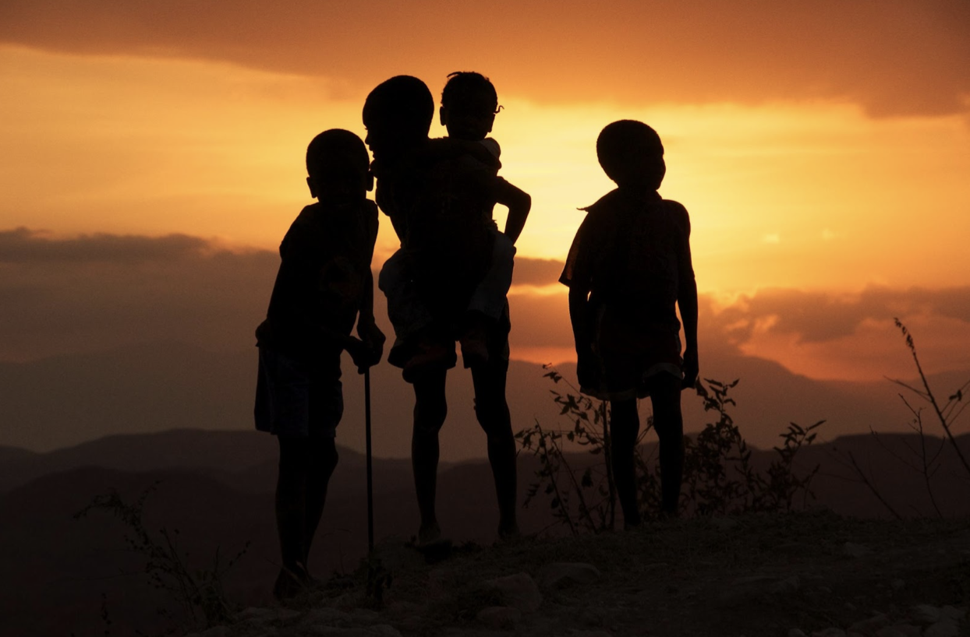
Implications
Enabling Growth:
Standardizing the process of calculating carbon offsets allows the project to shift its focus towards the next steps…
Integration of geospatial data to map change across the Central Plateau
Collaboration with Haiti Photo Project and other institutions
Exploration of drone imaging
Further analysis and publication
Notes:
As you saw in the previous slides, we created a standardized process to calculate carbon absorption and carbon payments, and our work will enable the Zanmi Kafe to grow. In the future we hope to collaborate with the Haiti photo project to create a map that shows how the Zanmi Kafe’s work directly impacted the livelihood of the farmers and their families in Haiti. Next we hope to explore drone imaging which would create a more efficient way to calculate carbon absorption of the trees and make a more streamlined way to pay the farmers. Finally we hope to further analyze our data and publish our research to serve as a model for other institutions.

Slide 11
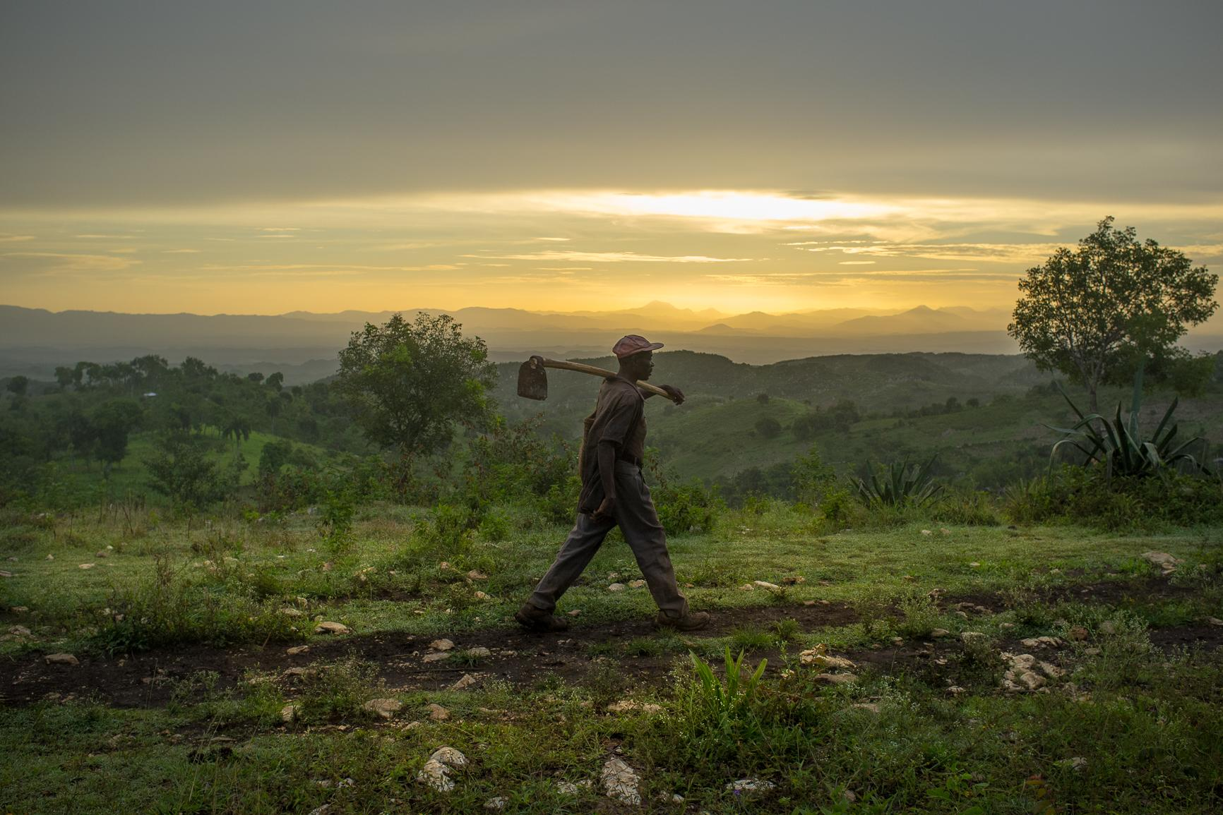
We Can Make A Difference
Notes:
This summer we learned that tackling climate change is a difficult feat. But with an idea and a little bit of data analysis, we can combat climate and social injustice, help the planet, and reduce our impact on the world

Slide 12

Thank you!

Slide 13
Sources
“Aral Sea.” Wikipedia, Wikimedia Foundation, 13 July 2021, en.wikipedia.org/wiki/Aral_Sea#/media/File:AralSea1989_2014.jpg.
Edegaard, Connie. “Climate Change Won't Wait.” OECD, 2013, www.oecd.org/environment/climate-change-wont-wait.htm.
Harvey, Chelsea. “Here's What We Know about Wildfires and Climate Change.” Scientific American, Scientific American, 13 Oct. 2017, www.scientificamerican.com/article/heres-what-we-know-about-wildfires-and-climate-change/.
IV, Robert Greenfield. “Blockchain Enabled Carbon Credit Markets.” Medium, Medium, 7 July 2020, robertgreenfieldiv.medium.com/blockchain-enabled-carbon-credit-markets-1a195520f0e1.
Mega, E. R. (2019, September 10). Burned areas of the Amazon could take centuries to fully recover. The Verge. https://www.theverge.com/2019/9/10/20858834/amazon-fire-brazil-forest-harm-recovery-century.
Monroe, Rob. “The Keeling CURVE.” The Keeling Curve, 19 Sept. 2018, keelingcurve.ucsd.edu/.
“Thank You Meme Animal Archives.” Betameme, 13 Feb. 2018, www.betameme.com/tag/thank-you-meme-animal/.
“What Cause Global Warming Effect?” What Cause Global Warming Effect?, 13 July 2015, geologylearn.blogspot.com/2015/07/what-cause-global-warming-effect.html.

